Slide 1
“Twitter Sentiment Analysis and Topic Modelling”
Internal Guide/External Guide:
Assi. Prof. Mrugendra Rahevar
Prepared by:
Patel Neel (16CE077)
Patel Pathik (16CE080)
Patel Ravi (16CE085)

Slide 2
Content
What is Sentiment analysis and its importance ?
What is Topic modelling and its importance?
Why Twitter Data for Analysis?
Objectives and scope of system
Project Plan
Role of Individuals
Software & Hardware Requirements
Functional Requirement
Non-functional Requirements
Implementation details
Screenshots
Challenges
Future Plans
Conclusion
Bibliography

Slide 3
What is Sentiment Analysis?
Sentiment analysis (also called opinion mining) is the automated process of identifying and extracting the subjective information that underlies a text. This can be either an opinion, a judgment, or a feeling about a particular topic or subject. The most common type of sentiment analysis is called ‘polarity detection’ and consists in classifying a statement as ‘positive’, ‘negative’ or ‘neutral’.
For example, let’s take this sentence: “I don’t find the app useful: it’s really slow and constantly crashing”. A sentiment analysis model would automatically tag this as Negative.

Slide 4
Why is Sentiment Analysis important?
In this world where most of the data is unstructured it’s hard to analyse data manually. But with the help of machine learning we can train a model to do so and easily carry out sentiment analysis on a huge set of data.
There are some advantages of sentiment analysis :
Scalability: let’s say you need to analyze hundreds of tweets mentioning a brand. While you could do that manually, it would take hours and hours of manual processing and would end up being inconsistent and impossible to scale. By performing Twitter sentiment analysis you can automate this task and obtain cost-effective results in a very short time.
Real-Time Analysis: Twitter sentiment analysis is critical to notice sudden shifts in customer moods, detect if critics and complaints are increasing and take action before the problem escalates. You can be monitoring your brand in real-time and get valuable insights that allow you to make changes or improvements when needed.
Consistent Criteria: analyzing sentiment in a text is a subjective task. When done manually, the same tweet may be perceived differently by two members of the same team, and the results will probably be biased. By training a machine learning model to perform sentiment analysis on Twitter, you can set the parameters to analyze all your data and obtain more consistent and accurate results.

Slide 5
What is Topic modeling ?
Topic modeling is an unsupervised machine learning technique that’s capable of scanning a set of documents, detecting word and phrase patterns within them, and automatically clustering word groups and similar expressions that best characterize a set of documents.
Topic Modelling is different from rule-based text mining approaches that use regular expressions or dictionary based keyword searching techniques. It is an unsupervised approach used for finding and observing the bunch of words (called “topics”) in large clusters of texts.
Topics can be defined as “a repeating pattern of co-occurring terms in a corpus”. A good topic model should result in – “health”, “doctor”, “patient”, “hospital” for a topic – Healthcare, and “farm”, “crops”, “wheat” for a topic – “Farming”.

Slide 6
Why is Topic modeling important?
Large amounts of data are collected everyday. As more information becomes available, it becomes difficult to access what we are looking for. So, we need tools and techniques to organize, search and understand vast quantities of information.
Topic modelling provides us with methods to organize, understand and summarize large collections of textual information. It helps in:
Discovering hidden topical patterns that are present across the collection
Annotating documents according to these topics
Using these annotations to organize, search and summarize texts

Slide 7
Why Twitter Data for Sentiment Analysis and Topic modelling?
Popular microblogging site
Short Text Messages of 140 characters
330+ million active users
500 million tweets are generated everyday
Twitter audience varies from common man to celebrities
Users often discuss current affairs and share personal views
Various subjects
Tweets are small in length

Slide 8
Objective and Scope
Objective
Sentiment Analysis to determine the attitude of the people is positive, negative or neutral towards the subject of interest.
Graphical representation of the sentiment in form of Pie-Chart.
To implement an algorithm for Topic Modelling of tweets fetched on particular topic.
Graphical representation of topics in form of various charts.
Scope
This project can be used in social media monitoring, market research, customer feedback, brand monitoring, customer services and other fields which include social interaction of people.
It would be helpful to the companies, political parties as well as to the common people.
It would be helpful to political party for reviewing about the program that they are going to do or the program that they have performed.
Similarly companies also can get review about their new product or newly released hardware or software.
Also the movie maker can take review on the currently running movie by analyzing tweets which can be included in brand monitoring.

Slide 9
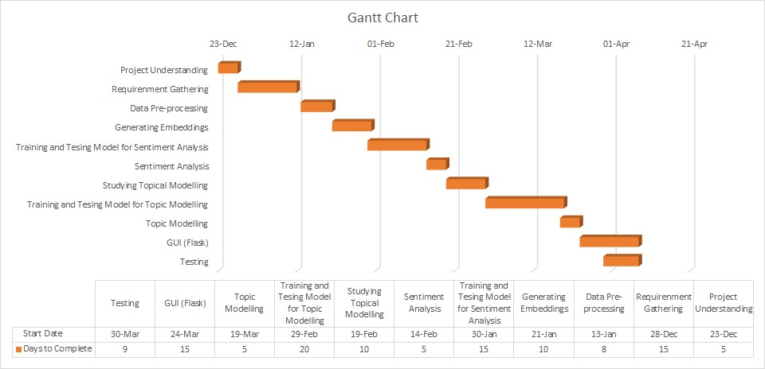
Project Planning

Slide 10
Roles of Individuals
Patel Neel (16CE077) | Sentiment Analysis, Data Pre-processing
Patel Pathik (16CE080) | Topical Modelling, Data Visualization
Patel Ravi (16CE085) | Topical Modelling, GUI (Flask)

Slide 11
Software & Hardware Requirement
Hardware Requirement
• RAM : 16 GB
• Processor : Intel i5
• Speed : 2.5 GHz
Software Requirement
• Operating System : Windows 10
• Coding Language : Python
• Frameworks : Bootstrap, Flask
• API : Twitter API
• Libraries : NLTK, Tensorflow, Keras, Gensim, Sklearn

Slide 12
Functional Requirement
System should be able to process live tweets and should be able to analyze data and classify each tweets polarity.
System should be able to fetch live tweets on the basis of hashtags, Geo-location, key word etc. and should be able to store it in file.
System should be able to use stored data to perform Topical Modelling on that.

Slide 13
Non-functional Requirement
User friendly and attractive GUI.
System should provide better accuracy.
To perform with efficient throughput and response time.

Slide 14
Data Flow diagram of Topic Modelling

Slide 15
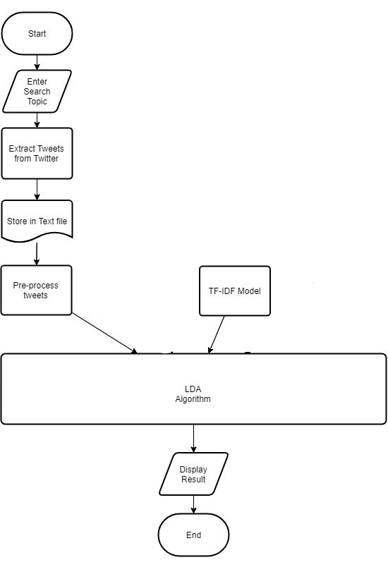

Slide 16
Activity diagram of Topic Modelling

Slide 17
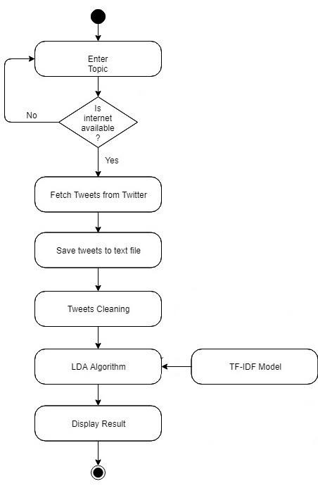

Slide 18
Data Flow diagram of Sentiment Analysis

Slide 19
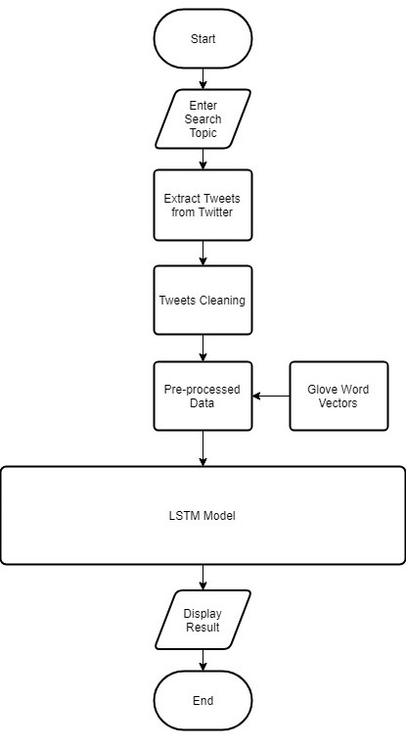

Slide 20
Activity diagram of Sentiment Analysis

Slide 21
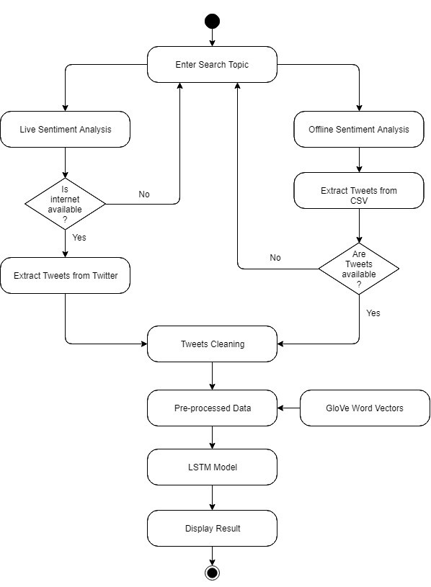

Slide 22
Implementation details of sentiment analysis
Implemented the model to provide a sentiment score between 0 to 1 with 0 being very negative and 1 being very positive. This was done by building a multi-class classification model i.e 10 class, one class for each decile.
There are 5 major steps involved in building this model
Get data
Generate embedding's
Model architecture
Model parameters
Train and test the model
Run the model

Slide 23
Implementation Details (cont..)
Get data
Used Stanford sentiment treebank data.
The dataset ‘dictionary.txt’ consists of 239,233 lines of sentences with an index for each line.
Another file ‘sentiment_values.txt’ which contains sentiment score along with index number.
The data is splited into 3 parts :
Train.csv : the main data which is used to train the model. (80% of overall data)
Val.csv : the validation dataset to be used to ensure the model does not overfit. (10%)
Test.csv : this is used to test the accuracy of the model post training. (10%)

Slide 24
Implementation Details (cont..)
Generate Embeddings
Prior to train model we converted each of the words into a word embedding.
One can think of word embedding as numerical representation of words to enable our model to learn.
We used pre-trained word embedding model known as GloVe.
An illustration of the process is shown in next slide, where each word is converted into an embedding and fed into a neural network.

Slide 25
Visualization of 4,00,000 words

Slide 27
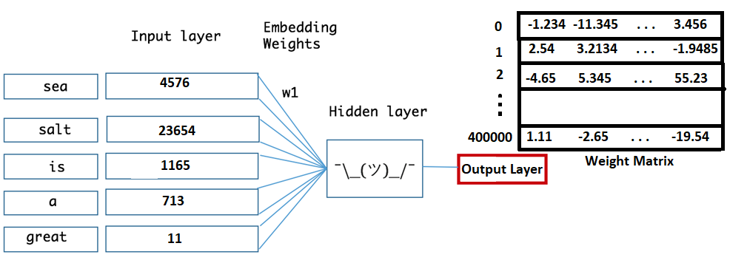
Implementation Details (cont..)

Slide 28
Implementation Details (cont..)
Model architecture
To train the model we used RNN (Recurrent Neural Network), known as LSTM (Long Short Term Memory).
The main advantage of this network is that it is able to remember the sequence of past data i.e. word in our case in order to make a decision on the sentiment of the word.
We created network using keras.
In order to estimate parameters such as dropout, no of cells etc we have performed a grid search with different parameter values and chose the parameters with best performance.

Slide 29
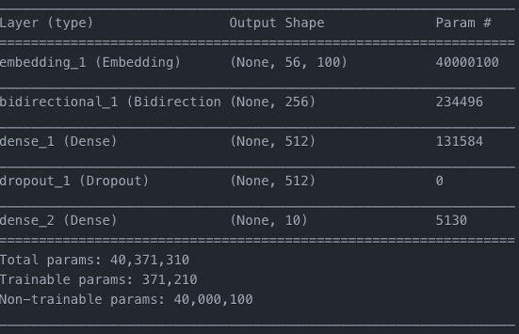
Implementation Details (cont..)

Slide 30
Implementation Details (cont..)
Model parameters
Activation Function: we have used ReLU (rectified linear activation unit) as the activation function. ReLU helps complex relationships in the data to be captured by the model.
Optimiser: We use adam optimiser, which is an adaptive learning rate optimiser.
Loss function: We have trained a network to output a probability over the 10 classes using Cross-Entropy loss, also called Softmax Loss.
Notes:
It is very useful for multi-class classification.

Slide 31
Implementation Details (cont..)
Train and test the model
We have run the training on a batch size of 2000 items at a time.
The training is set to run for 25 epochs.
We have enabled early stopping to overcome overfitting.
Early stopping is a method that allows us to specify an arbitrary large number of training epochs and stop training once the model performance stops improving on a hold out/validation dataset.
The model on the test set of 10 class sentiment classification provides a result of 78.6% accuracy.

Slide 32
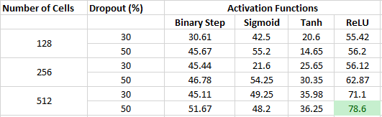
Accuracy Table

Slide 33
Implementation of Topic Modelling
LDA Algorithm
In natural language processing, the latent Dirichlet allocation (LDA) is a generative statistical model that allows sets of observations to be explained by unobserved groups that explain why some parts of the data are similar. For example, if observations are words collected into documents, it posits that each document is a mixture of a small number of topics and that each word's presence is attributable to one of the document's topics.
LDA assumes documents are produced from a mixture of topics. Those topics then generate words based on their probability distribution. Given a dataset of documents, LDA backtracks and tries to figure out what topics would create those documents in the first place.

Slide 34
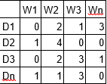
Implementation Details (cont..)
LDA is a matrix factorization technique. In vector space, any corpus (collection of documents) can be represented as a document-term matrix. The following matrix shows a corpus of N documents D1, D2, D3 … Dn and vocabulary size of M words W1,W2 .. Wn. The value of i,j cell gives the frequency count of word Wj in Document Di.

Slide 35
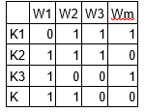
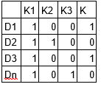
Implementation Details (cont..)
LDA converts this Document-Term Matrix into two lower dimensional matrices – M1 and M2.
M1 is a document-topics matrix and M2 is a topic – terms matrix with dimensions (N, K) and (K, M) respectively, where N is the number of documents, K is the number of topics and M is the vocabulary size.

Slide 36
Implementation Details (cont..)
Notice that these two matrices already provides topic word and document topic distributions, However, these distribution needs to be improved, which is the main aim of LDA. LDA makes use of sampling techniques in order to improve these matrices.
It Iterates through each word “w” for each document “d” and tries to adjust the current topic – word assignment with a new assignment. A new topic “k” is assigned to word “w” with a probability P which is a product of two probabilities p1 and p2.
For every topic, two probabilities p1 and p2 are calculated. P1 – p(topic t / document d) = the proportion of words in document d that are currently assigned to topic t. P2 – p(word w / topic t) = the proportion of assignments to topic t over all documents that come from this word w.

Slide 37
Implementation Details (cont..)
The current topic – word assignment is updated with a new topic with the probability, product of p1 and p2 . In this step, the model assumes that all the existing word – topic assignments except the current word are correct. This is essentially the probability that topic t generated word w, so it makes sense to adjust the current word’s topic with new probability.
After a number of iterations, a steady state is achieved where the document topic and topic term distributions are fairly good. This is the convergence point of LDA.

Slide 38
Screenshots

Slide 39
Screenshots

Slide 40
Challenges
People express opinions in complex ways.
In opinion texts, lexical content alone can be misleading
Intra-textual and sub-sentential reversals, negation, topic change are common
Rhetorical devices/modes such as sarcasm, irony, implications, etc.
Unstructured and also non-grammatical
Lexical variation
Out of vocabulary words
Extensive usage of acronyms like asap, lol etc and emojis.

Slide 41
Future Plans
User can upload their files if required.
Analysing sentiment on emoji’s.
Interpreting sarcasm.
Future research can be done with possible improvement such as more refined data and more accurate algorithm.
Potential improvement can be made to our data collection and analysis method.
Merging Topic modelling and Sentiment analysis for better analysis.

Slide 42
Conclusion
We conclude that using word embedding technique in LSTM model it is easier to classify the tweets and more we improve the training dataset more we can get accurate results. Additionally, using TF-IDF model along with LDA algorithm we can more accurately perform topic modelling.

Slide 43
Bibliography
https://www.kaggle.com/thoughtvector/customer-support-on-twitter (Dataset)
https://nlp.stanford.edu/sentiment/code.html (Dataset - Stanford)
https://monkeylearn.com/sentiment-analysis/ (Sentiment Analysis)
https://paperswithcode.com/task/topic-models/latest (Topic Clustering)
https://medium.com/nanonets/topic-modeling-with-lsa-psla-lda-and-lda2vec-555ff65b0b05 (Topic Clustering)
https://devopedia.org/text-clustering (Topic Clustering)
https://machinelearningmastery.com/use-word-embedding-layers-deep-learning-keras/ (Dense Embedding)
https://towardsdatascience.com/sentiment-analysis-for-text-with-deep-learning-2f0a0c6472b5 (Dense Embedding)

Slide 44
Thank you

